Slide 1


LSCU Credit Union Economic
& Regulatory Update

Slide 2
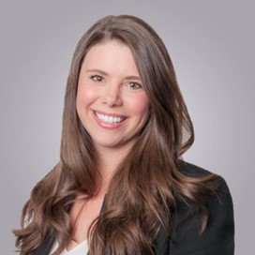


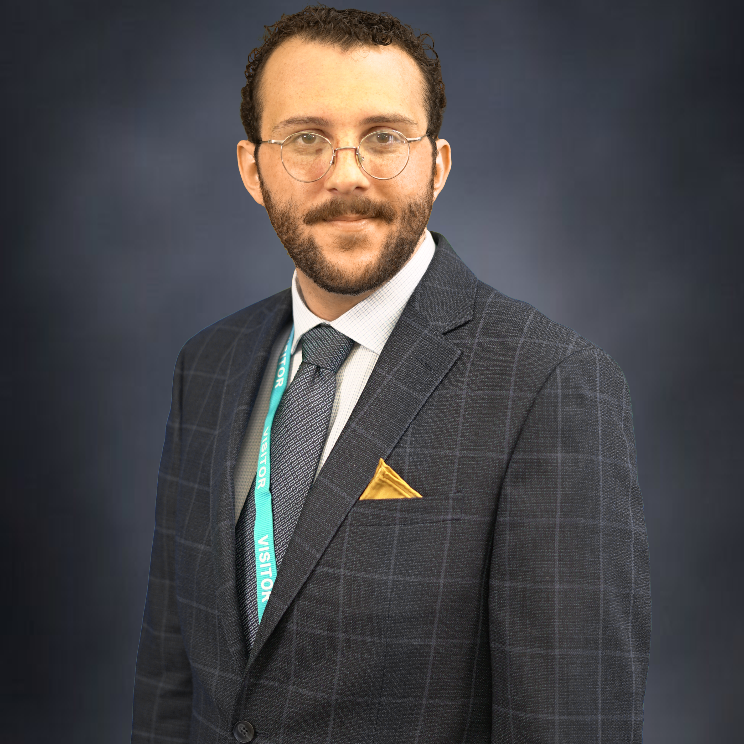
Presenters
Samantha Beeler
President, LSCU
Dawit Kebede, PhD
Senior Economist, CUNA
Grace Newcombe
Sr. Director of Federal Advocacy & Communications, LSCU
David Pace
Manager of Regulatory Advocacy, LSCU

Slide 3
How Did We Get Here?
March 10, 2023
March 12, 2023
March 16, 2023
March 19, 2023
Silicon Valley Bank Collapse
Signature Bank of New York Collapse
First Republic Bank of San Francisco Capital Injection
Credit Suisse Bought by UBS

Slide 4
Meeting with Treasury
On March 22, League Presidents met with Assistant Secretary for Financial Institutions Graham Steele of the U.S. Department of Treasury.
Treasury reassured the group that the financial services space is strong, and they will support credit unions in the same manner as banks.
Treasury is not interested in setting insurance limits.
We stressed the unique structure of credit unions and the funding of the Share Insurance Fund.
Credit unions will remain part of the discussion with a seat at the table.

Slide 5
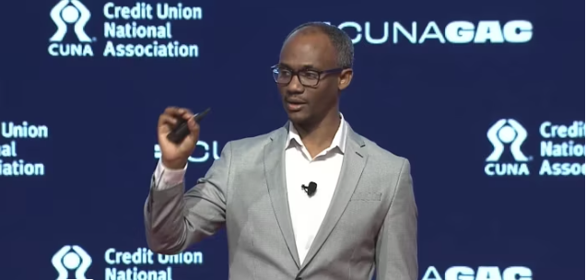
Economic Update with
Dawit Kebede, PhD

Slide 6

Legislation
Insurance Limits/Expansion of Dodd Frank
Central Liquidity Facility
Member Business Lending
Field of Membership

Slide 7
League Resources
Talking Points
  As not-for-profit financial cooperatives, our first priority is the people we serve.
  Credit unions remain well-capitalized, healthy, safe, and sound.
  Nearly 92% of AL credit union deposits, 93% of FL credit union deposits, and 92% of GA credit union deposits are insured.
  Credit union deposits are insured up to at least $250,000 per individual depositor.
  Credit union members have never lost a penny of insured savings at a federally insured credit unions.
Media and Member Inquiries
Media Kit
Account Insurance Estimator

Slide 8
What We're Hearing
Continued instability in the banking system, mainly originating with regional banks.
By comparison, the credit union system has demonstrated far greater stability.
Moderate inflow of deposits to the credit union system from those worried about the banking system.

Slide 9
What We're Seeing
Two main causes of recent bank collapses
  Uninsured Deposits
  Risk Concentration
Why credit unions are different
  Very few uninsured deposits
  System is well-capitalized compared to the regional banks
  Local nature of credit unions limits risk concentration

Slide 10
Questions?

Slide 11
ADJOURN

