Slide 1
Economic and CU Update
League of Southeastern Credit Unions
Dawit Kebede, Senior Economist
Credit Union National Association
Dkebede@cuna.coop

Slide 2
Gross Domestic Product
Source: BEA
Notes:
Trends in macro gives us an understanding for Fed’s action, Then I will talk about how Fed policy is impacting financial stability. Finally, I will cover trends in CU operations

Slide 3
Quarterly Annualized Growth Rate(%) – Housing Investment and Consumption (Source: BEA)

Slide 4
Housing Permits, Starts, and Completions ('000 units)
Notes:
Regional banks are significant source of finance for commercial real estate. The financial instability will mean less lending in addition to the high cost of borrowing which will further lower investment. Fed’s GDP projection is 0.4% for the year. Q1 real time tracking is 3.2%. Hence, a significant slow down is ahead.

Slide 5
Labor Market
4.8 million non-farm employment gains in 2022.
  815K in the first two months of 2023
Unemployment rate at 3.6%
Prime age (25-54) employment to pop ratio back to pre-pandemic
High Quit rates - moderating
High U/V ratio
Notes:
Strong labor market – Implies on time payment of loans. And people are also more likely to take out loans in they have a steady income

Slide 6
Unemployment and Non-farm Job openings
Thousands
Notes:
This tightness is reason for increased inflation (service inflation) and the FED watches this closely.

Slide 7
Monthly Inflation Contribution to Headline CPI
Source: BLS
Notes:
Year-over-year inflation in February was 6%.

Slide 8
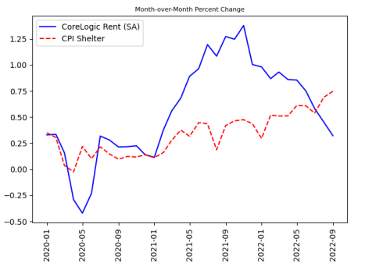
Shelter Inflation
Headline and CPI inflation will be 1.05 and 1.34 percentage points higher, respectively, from Sep 2022 to September 2023 as a result of above-average shelter inflation”
Cotton and O’Shea ( Feb 16, 2023), Federal Reserve Bank of Boston
“
Notes:
Shelter comprises a third of the headline CPI and over 40% of the core CPI. The most important factor supporting high future CPI-Shelter growth is that a large part of past growth in market rents had not been capture in CPI shelter as of September 2022.

Slide 9
Federal Funds Rate
Source: St Louis FRED

Slide 11
Inverse relationship between market interest rate changes and bond price changes!
Stylized example:
5-year Treasury with a 2% coupon purchased at par
Duration (weighted average life) of ~ 4.5 years
-Duration x change in market rates ~ approximate change in bond price
-4.5 (years) x .025 (change in market rates) = -11.25%

Slide 15
Credit Union Profile
Source: NCUA
 | Debt/Assets | Uninsured Deposits/ Assets
10th Percentile | 0% | 0%
25th Percentile | 0% | 0%
Median | 5% | 3%
75th Percentile | 21% | 6%
90th Percentile | 38% | 10%

Slide 16
LSCU Member States Insured Deposits
LSCU Member States | Percent Insured CU Deposits (min-max)
Alabama | 91.7% (78.7% - 100%)
Georgia | 91.9% (66.9% - 100%)
Florida | 92.7% (12.2% - 100%)
Notes:
CUs with low rate of insured deposits are small asset credit unions with sufficient net worth ratio and equity ratio(which includes unrealized losses)

Slide 17
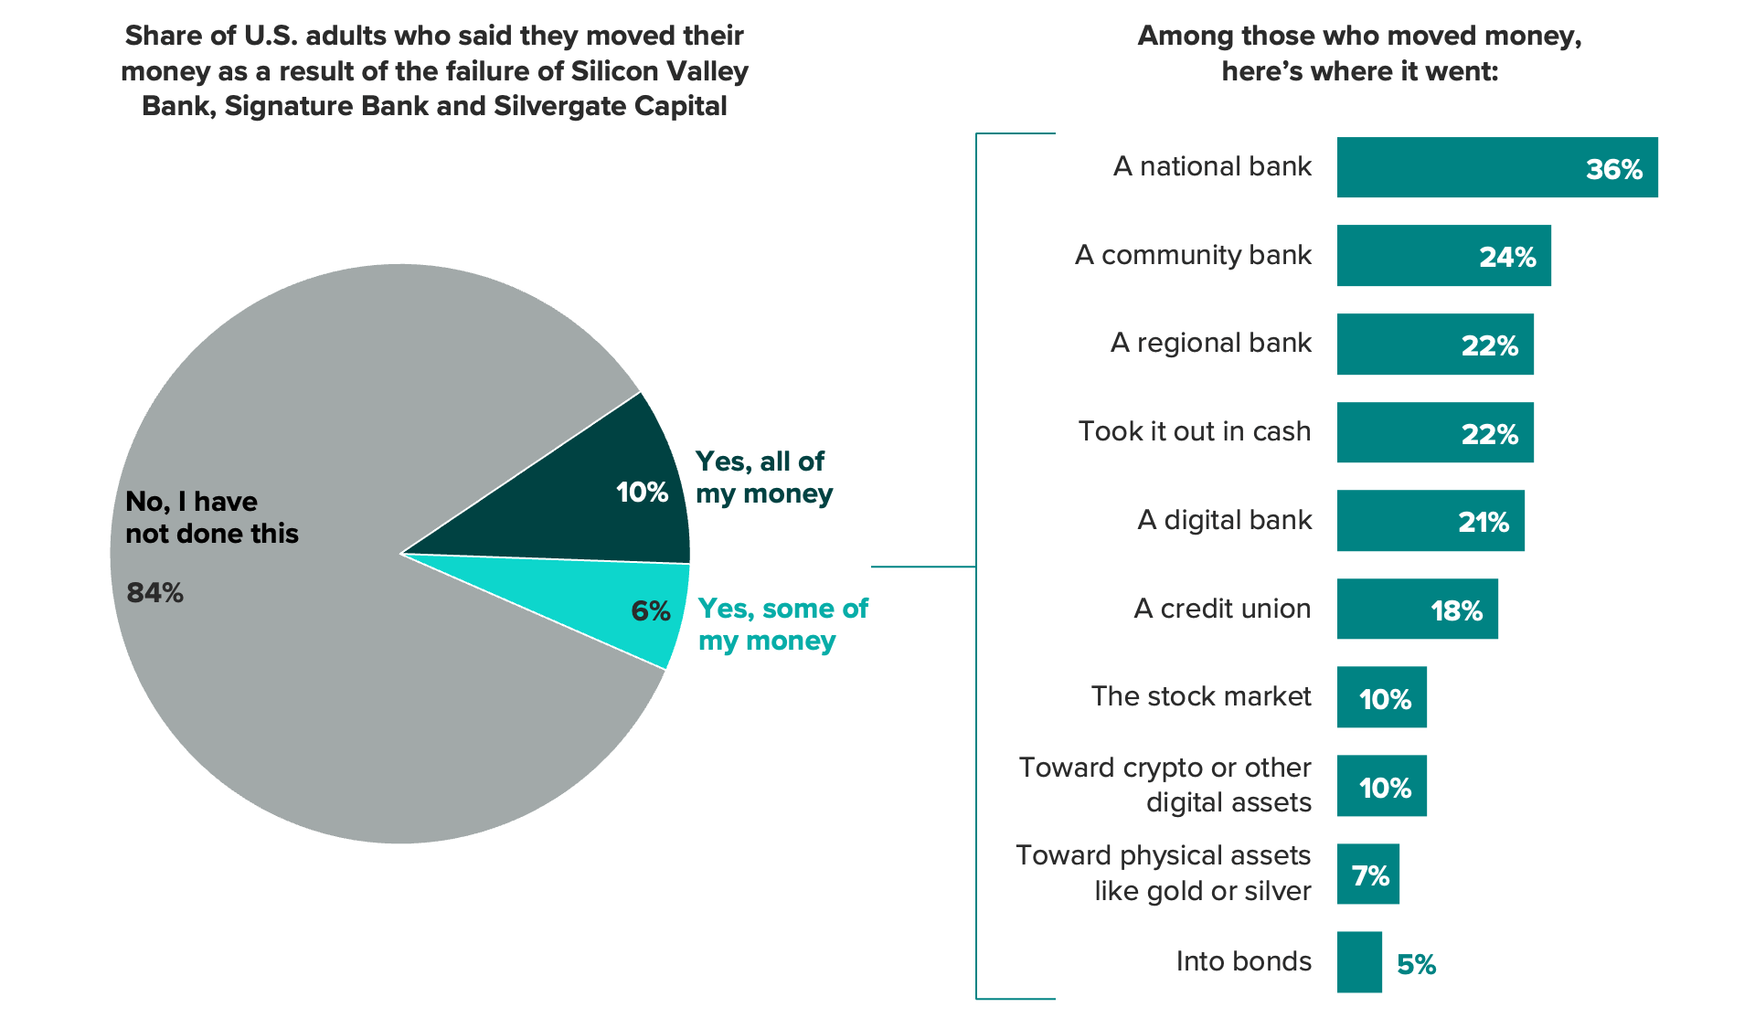
Source: Morning Consult 3/22/23.

Slide 18
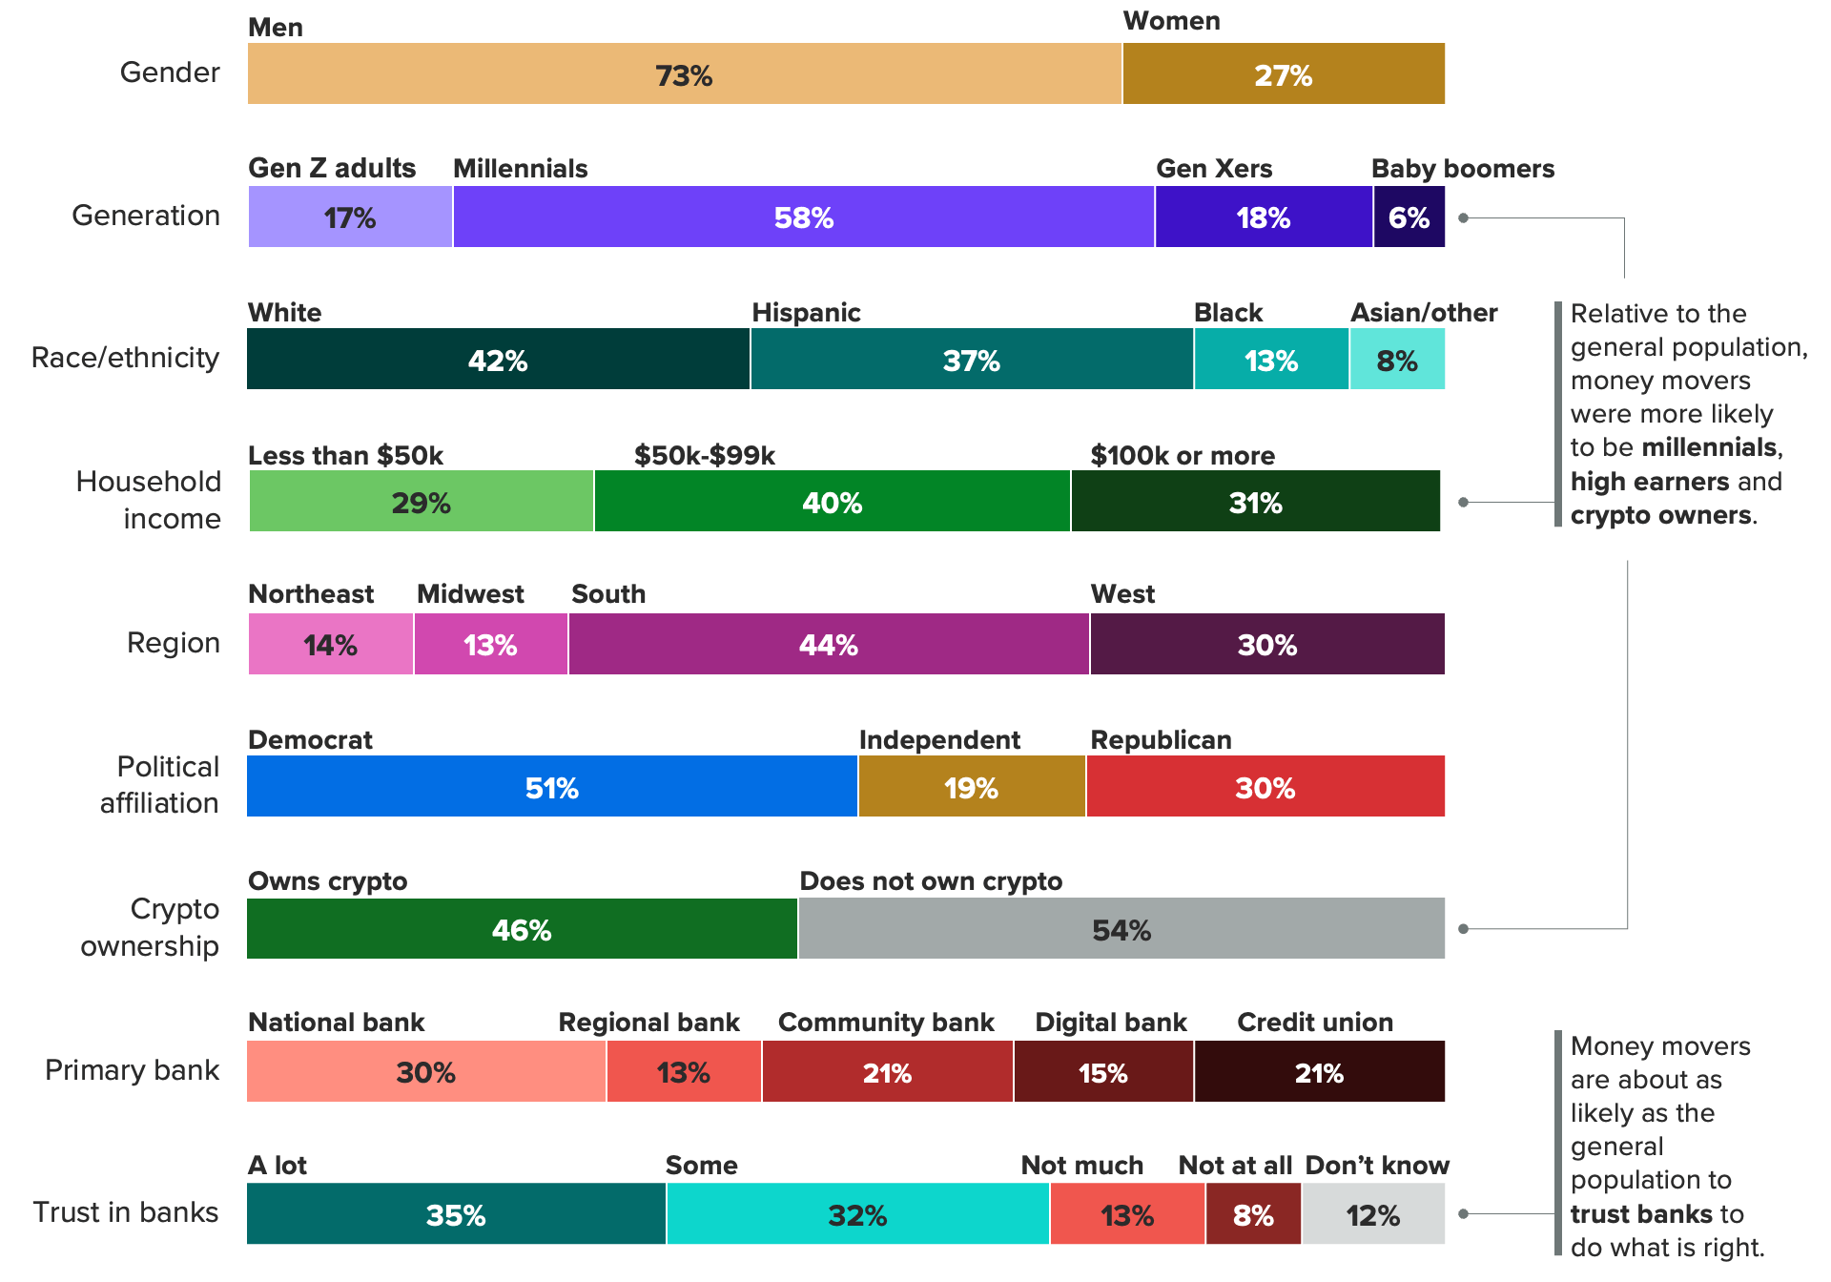
The demographic makeup of adults who moved money because of the recent bank failures
Source: Morning Consult 3/22/23.

Slide 19
CUNA Voters Poll
Fredrick Polls. January 2023. N=2,500.
Trust, Service & Community Focus
 | CU Members | Nonmembers | Difference
Can trust them (% very positive) | 94% | 86% | 8%
Knows you (% very positive) | 83% | 69% | 14%
Responsive customer service (% very positive) | 97% | 92% | 5%
Provides technology to do remote banking | 94% | 95% | -1%
Serves diverse customer base of all income levels/ethnicities (% very positive) | 95% | 93% | 2%
In touch with local community (% very positive) | 95% | 83% | 12%
Cares about local community (% very positive) | 94% | 79% | 15%
Notes:
Credit union members reflect substantially greater financial resilience than consumers who do not use credit unions. Credit unions members are significantly more likely to use financial education and counseling services. Their members are therefore both more likely to engage in behaviors that improve financial well-being (e.g., establish an emergency savings account) AND to say that their financial institution has actually improved their financial well-being. In fact, credit union members are two times more likely than non-members to say they’ve used a personal financial education/counseling service. This may explain why consumers who are not credit union members are nearly 2x more likely than credit union members to say they do NOT have a modest emergency savings account. Credit union members are (perhaps not surprisingly) over 50% more likely than nonmembers to say their institution has positively impacted their financial well-being.
Maintaining modest emergency savings balances is widely recognized as a key contributor to financial resilience. In fact, according to the Consumer Financial Protection Bureau, savings and financial cushions provide the greatest differentiation between people with different levels of financial well-being. Of all the factors the Bureau examined, disparities in financial well-being are greatest between subgroups that have different levels of liquid savings. The average financial well-being score for adults with the lowest level of savings (less than $250) is 41, which is roughly 40% lower than the average score of for adults with the highest level of savings ($75,000 or more). The Bureau emphasizes the importance of savings in helping people to feel financially secure – which is one of the essential elements of financial well-being.
Similarly, research conducted by the Financial Health Network reveals people who start saving for emergencies experience measurable benefits within 12 months - both in how they think about planning for emergencies and how they actually manage their finances. Consumer Financial Protection Bureau. “Financial well-being in America.” September 2017. P.6. See Financial Health Network Emergency Savings Initiative. https://finhealthnetwork.org/research/3-ways-to-measure-the-finhealth-effects-of-emergency-savings/
CFPB notes that financial counseling can support people in learning skills needed to successfully take or stick with unfamiliar or difficult actions. The Bureau cites a number of studies:
* A study by the World Bank Group concluded that individualized financial counseling helped participants undertake difficult actions or tasks they had not done before, such as regularly preparing a budget or opening a bank savings account.
* Another study surveyed participants three months after receiving credit counseling and found that nearly three-fourths of survey respondents reported paying their debts more consistently after enrolling in the program.
* A randomized field experiment of first-time homebuyers tested the impact of goal setting and external monitoring on mortgage delinquency. The study found that participation in an education module that included lessons in financial planning and goal setting with periodic follow-up by a third-party “monitor,” lowered delinquency and default rates for at least two years after home purchase.

Slide 20
CUNA Voters Poll: High Intensity
Fredrick Polls. January 2023. N=2,500.
Trust, Service & Community Focus
 | CU Members | Nonmembers | Difference
Can trust them (% very positive) | 60% 1.6x | 38% | 22%
Knows you (% very positive) | 33% 1.3x | 25% | 8%
Responsive customer service (% very positive) | 67% 1.5x | 46% | 21%
Provides technology to do remote banking | 51% --- | 51% | 0%
Serves diverse customer base of all income levels/ethnicities (% very positive) | 46% 1.2x | 39% | 7%
In touch with local community (% very positive) | 55% 2.0x | 28% | 27%
Cares about local community (% very positive) | 50% 1.9x | 26% | 24%
Notes:
Credit union members reflect substantially greater financial resilience than consumers who do not use credit unions. Credit unions members are significantly more likely to use financial education and counseling services. Their members are therefore both more likely to engage in behaviors that improve financial well-being (e.g., establish an emergency savings account) AND to say that their financial institution has actually improved their financial well-being. In fact, credit union members are two times more likely than non-members to say they’ve used a personal financial education/counseling service. This may explain why consumers who are not credit union members are nearly 2x more likely than credit union members to say they do NOT have a modest emergency savings account. Credit union members are (perhaps not surprisingly) over 50% more likely than nonmembers to say their institution has positively impacted their financial well-being.
Maintaining modest emergency savings balances is widely recognized as a key contributor to financial resilience. In fact, according to the Consumer Financial Protection Bureau, savings and financial cushions provide the greatest differentiation between people with different levels of financial well-being. Of all the factors the Bureau examined, disparities in financial well-being are greatest between subgroups that have different levels of liquid savings. The average financial well-being score for adults with the lowest level of savings (less than $250) is 41, which is roughly 40% lower than the average score of for adults with the highest level of savings ($75,000 or more). The Bureau emphasizes the importance of savings in helping people to feel financially secure – which is one of the essential elements of financial well-being.
Similarly, research conducted by the Financial Health Network reveals people who start saving for emergencies experience measurable benefits within 12 months - both in how they think about planning for emergencies and how they actually manage their finances. Consumer Financial Protection Bureau. “Financial well-being in America.” September 2017. P.6. See Financial Health Network Emergency Savings Initiative. https://finhealthnetwork.org/research/3-ways-to-measure-the-finhealth-effects-of-emergency-savings/
CFPB notes that financial counseling can support people in learning skills needed to successfully take or stick with unfamiliar or difficult actions. The Bureau cites a number of studies:
* A study by the World Bank Group concluded that individualized financial counseling helped participants undertake difficult actions or tasks they had not done before, such as regularly preparing a budget or opening a bank savings account.
* Another study surveyed participants three months after receiving credit counseling and found that nearly three-fourths of survey respondents reported paying their debts more consistently after enrolling in the program.
* A randomized field experiment of first-time homebuyers tested the impact of goal setting and external monitoring on mortgage delinquency. The study found that participation in an education module that included lessons in financial planning and goal setting with periodic follow-up by a third-party “monitor,” lowered delinquency and default rates for at least two years after home purchase.

Slide 21
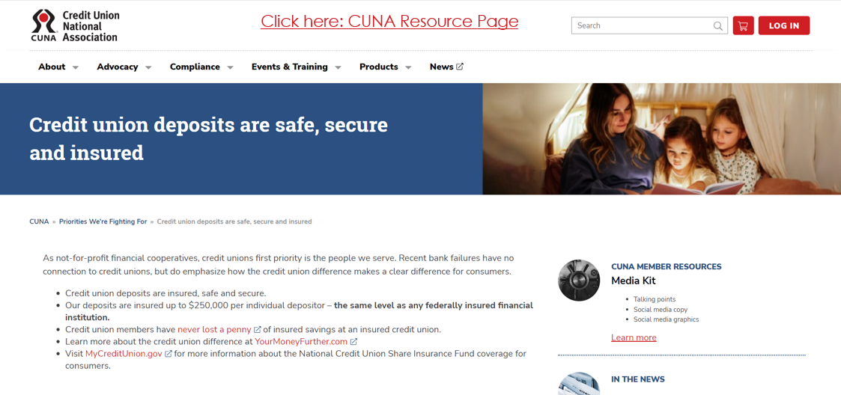
Click here: CUNA Resource Page

Slide 22
Forbes: five ways to insure your excess deposits...
3. Consider Moving Some of Your Money to a Credit Union
Credit unions can offer a safe haven for excess bank deposits. While credit unions are not covered by FDIC insurance protections, they are still protected. The National Credit Union Administration (NCUA) insures deposits up to $250,000 per depositor, per credit union, for each ownership category. You can use the NCUA’s Share Insurance Estimator to determine how much of your deposits would be covered.
Aside from making it possible to insure excess deposits, credit unions can offer some other perks. For instance, you may benefit from higher interest rates on deposit accounts and lower fees, compared to traditional banks. You may also find that credit unions offer more favorable interest rates on loans.
If you’re considering opening a credit union account, approach it the same way you would a bank account. That means comparing the fees you may pay and the interest you could earn, as well as other features such as online and mobile banking access or the size of its ATM network.
https://www.forbes.com/advisor/banking/ways-to-insure-excess-deposits/

Slide 24
Lots of Policy Questions...
Should insured deposit coverage increase?
  If so – to what level? All deposits?
  Do CUs want parity?
Thoughts on bank term funding participation?

Slide 25
Lower liquidity levels …
Source: NCUA and CUNA.
Notes:
Not surprisingly, with unusually slow deposit growth and strong loan growth, credit union liquidity has fallen dramatically this year.
With the national average over 80.0%, many credit unions are now fully “loaned up” and facing significant liquidity challenges.
However, with our loan and savings growth forecasts, we don’t expect liquidity to tighten much more next year, with the loan-to-savings rising only by about a point during the year.

Slide 26
Lower savings growth….
Notes:
Some CUs are offering attractive rates for CDs to increase deposits. We have seen CD deposit go up since August of 2022.

Slide 27
Paying Back. On Time
Slow-payers and no-payers near all-time lows
Lowest in modern history!
Source: NCUA and CUNA.

Slide 28
Bottom-Line Results Under Pressure
25-Year High!
Notes:
Pressure on interest income caused by inverted yield curves, low income from home mortgage refinance, increase in operating expenses will add pressure.

Slide 29
Appendix

Slide 30
Economic forecast
January 2023
 | Past results |  |  |  | Forecasts
 | Previous 10 Yr. Avg |  | 2022 |  | 2023:1 |  | 2023:2 |  | 2023:3 |  | 2023:4 |  | 2023
Growth rates:
Economic Growth (% chg GDP)* | 2.1% |  | 2.1% |  | 1.5% |  | 1.5% |  | -1.0% |  | 0.0% |  | 0.5%
Inflation (CPI, 12 mth % chg) | 2.2% |  | 6.5% |  | 6.0% |  | 5.0% |  | 4.0% |  | 3.5% |  | 3.5%
Unemployment Rate (BLS) | 6.0% |  | 3.5% |  | 3.7% |  | 3.8% |  | 4.0% |  | 4.2% |  | 4.2%
Federal Funds Rate (effective) | 0.58% |  | 4.33% |  | 4.88% |  | 5.10% |  | 5.10% |  | 5.10% |  | 5.10%
10-Year Treasury Rate | 2.11% |  | 3.88% |  | 3.50% |  | 3.50% |  | 3.50% |  | 3.50% |  | 3.50%
10-Year-Fed Funds Spread | 1.53% |  | -0.45% |  | -1.38% |  | -1.60% |  | -1.60% |  | -1.60% |  | -1.60%
*Percent change, annual rate. All other numbers are end-of-period values.

Slide 31
Economic Forecast
January 2023
Economic Growth. After small declines in real GDP in the first two quarters of 2022, modest growth resumed in the third quarter. The fourth quarter started out quite strong but showed signs of softening in December. We expect continued weakness moving into 2023, with a mild recession beginning in the second half. With the Federal Reserve keeping the Federal Funds rate close to 5% throughout the year, the headwinds to various spending categories will mount. Residential construction and business investment will be hardest hit, but higher interest rates will also slow consumer spending. Weak growth or outright recessions at many or the US’s major trading partners will hurt exports. We expect GDP growth of 0.5% for the full year 2023, down from 1% in 2022.
Inflation. The really encouraging news as 2022 came to a close was the substantial improvement in inflation over the past several months. After peaking at 9% in June, the trailing twelve month increase in the consumer price index (CPI) was down to 6.4% as of December. The ”core” inflation rate (all items less food and energy) peaked at 6.7% in September and was down to 5.7% in by yearend. The slowdown in the all-items measure is due to a sharp drop in inflation in the fourth quarter (to only 1.8% at an annualized rate) caused largely by falling gasoline prices. The more sticky core index also fell in the fourth quarter, but only to 3.2% at an annual rate. It’s too early to declare victory in the battle against inflation, but if it continues to moderate as it did in the fourth quarter, the chances of avoiding a recession increase. We expect inflation for all of 2023 to come in at 3.5%.
Unemployment. The labor market has softened but by historical measures it is still quite strong. The three-month moving average number of monthly non-farm payrolls increases was 247,000 in December, down from 580,000 in January. The unemployment rate began 2022 at 4%, and has been bouncing between 3.5% and 3.7% since June. These are full-employment type numbers. If the unemployment rate remains between 3.5% and 4% while inflation continues to slow and approach the Fed’s 2% target, the economy will have achieved a soft landing. So far so good, but if the slowing in job growth overshoots and becomes a contraction, a recession will have begun. We forecast unemployment to end the year at 4.25%which is consistent with a mild recession.
Interest Rates. As we entered 2023, the Fed Funds rate at between 4.25% and 4.5% was 4.25 points higher than a year ago. Other short-term rates rose by similar amounts. The yield on the 10-year Treasury Note was just over 3.5%, up from 1.5% a year ago. We expect the Fed Funds rate to finish 2023 at around 5%, and the 10-year Treasury rate to remain in a trading range around 3.5% throughout the year. The fact that that long-term rates rose by so much less than short rates last year suggests that the bond market is quite convinced there will be a recession this year. Last January, the ten-year yield was about 80 basis points above the two-year rate. As of January 2023, the two-year rates exceeds the ten-year rate by 70 bp, a reversal of 150 bp. As we’ve noted before, since World War II, every time the yield curve has inverted this much, a recession has followed within six to twelve months. Perhaps this time will be different. The smaller increase in long rates could be due not to investors expecting a recession, but instead expecting a return to more modest inflation a year or two down the road without a recession. But don’t count on it.

Slide 32
Credit union forecast***
January 2023
 | Past results |  |  |  | Forecasts
 | Previous 10 Yr Avg |  | 2022 |  | 2023:1 |  | 2023:2 |  | 2023:3 |  | 2023:4 |  | 2023
Growth rates:
Savings growth | 7.8% |  | 3.7% |  | 3.6% |  | 0.9% |  | 0.5% |  | 1.0% |  | 6.0%
Loan growth | 7.5% |  | 19.0% |  | 0.4% |  | 2.6% |  | 2.5% |  | 1.6% |  | 7.0%
Asset growth | 7.7% |  | 4.5% |  | 3.7% |  | 0.9% |  | 0.5% |  | 1.2% |  | 6.25%
Membership growth | 3.3% |  | 4.8% |  | 1.0% |  | 0.90% |  | 0.8% |  | 0.4% |  | 3.0%
Liquidity:
Loan-to-share ratio** | 76.3% |  | 82.1% |  | 79.5% |  | 80.8% |  | 82.4% |  | 82.8% |  | 82.83%
Asset quality:
Delinquency rate** | 0.87% |  | 0.58% |  | 0.60% |  | 0.64% |  | 0.67% |  | 0.70% |  | 0.70%
Net charge-off rate* | 0.56% |  | 0.32% |  | 0.40% |  | 0.45% |  | 0.50% |  | 0.50% |  | 0.45%
Earnings:
Return on average assets (ROA)* | 0.82% |  | 0.82% |  | 0.55% |  | 0.55% |  | 0.65% |  | 0.60% |  | 0.60%
Capital adequacy:
Net worth ratio** | 10.6% |  | 10.5% |  | 10.1% |  | 10.1% |  | 10.2% |  | 10.3% |  | 10.3%
*Quarterly data, annualized. **End of period ratio.
*** At the time of preparation this forecast, the latest available credit union data for 2022 was of as November. We have projected year-end values based on November data. Full-year data will soon be available from CUNA’s December Monthly Credit Union Estimates found here.

Slide 33
Credit Union Forecast*
January 2023
Savings (Deposit) Growth. Savings growth for all of 2022 came in at a paltry 3.7%, following the torrid 35% growth over the preceding two years. Last year’s sharp slowdown was in part due to that previous strength: drawing down excess savings accumulated during COVID shutdowns. Disintermediation and cross-intermediation to internet banks and money funds also played a large role in the second half as short-term interest rates soared. We expect savings growth to strengthen to 6% in 2023 as a recession turns consumers more cautious. Our forecast for only another 50 bp to 75 bp increase in the Fed Funds rate this year (compared to the 425 bp increase last year) coupled with the possibility that much of the money that might have been attracted by higher rates might already have moved (perhaps wishful thinking) imply that the worst of the disintermediation pressure may be over. However, this will remain a very competitive year for deposit acquisition and retention.
Loan Growth. Credit union lending was on a tear so far last year, with the 19% increase in loans outstanding the strongest calendar-year growth in almost four decades. This robust growth had several causes: a surge in pent up consumer demand after COVID, the higher prices of products members financed, slower prepayments on mortgage loans due to higher interest rates, and the fact that many credit unions were slow to raise loan rates as market rates rose. With credit union pricing largely having caught up with the market and a slowing economy, in 2023 loan growth will slow to around 7%.
Liquidity. The combination of very soft deposit growth and torrid loan growth caused credit union liquidity to plummet last year. The average loan-to-savings ratio rose by more than twelve points during the year to 82.1%, by far the largest one-year increase in the past four decades. This follows close on the heels of the largest one-year decrease in the ratio, by just over ten points in 2020. For credit union liquidity flows, last year was largely a reversal of the earlier dramatic effects of the COVID pandemic. We look for the the loan-to-savings ratio to drift up by less than a point this year.
Asset Quality. Credit union delinquency and net charge-off rates ended 2022 at historically low levels because of a strong job market, robust household balance sheets, and the rapid growth of the denominator (loans) in these ratios. With a weakening job market and slowing loan growth, delinquency and charge-off rates will rise in 2023 but will still end the year below their long-term averages.
Earnings. Last year’s return on assets (ROA) of 0.82% was a reduction from the 1.07% of 2021, but in line with the average for the preceding ten years. We expect a further decline to 60 bp in 2023 because of: an increase in provision expense (due more to a rise in charge-offs than the effects of CECL), pressure on net interest income caused by an inverted yield curve, and the scarcity of the income that flows from mortgage refinances. It will be difficult to lower operating expenses this year considering the need to increase compensation in response to the inflation of the past eighteen months.
* At the time of preparation this forecast, the latest available credit union data for 2022 was of as November. We have projected year-end values based on November data. Full-year data will soon be available from CUNA’s December Monthly Credit Union Estimates found here.

