Slide 1
Hilton News

Slide 2
HILTON NEWS
Pioneering
a new standard of hotel clean.
The Hilton CleanStay program was developed to provide our guests with complete peace of mind during future stays at any of Hilton’s 18 brands.
Notes:
KEY FEATURES
-Hilton CleanStay Room Seal to indicate that guest rooms have not been accessed since they were cleaned
-Increased focused disinfection of top 10 high touch areas in guest rooms like light switches and door handles
-Increased cleaning and disinfection frequency of public areas
-Guest-accessible disinfecting wipes at entrances and high traffic areas
-Enhanced cleaning and disinfection for fitness centers
-Enhanced cleaning & operational changes to restaurants, bars, in-room dining and meeting spaces
-Reduced paper amenities (like pads and guest directories) in rooms
-Industry-leading contactless check-in and check-out with Digital Key at more than 4,700 properties globally
-Evaluation of new technologies like electrostatic sprayers with disinfecting mist and ultraviolet light to sanitize surfaces and objects
-Enhanced Team Member safety and well-being with personal protective equipment and enhanced training and protocols

Slide 3
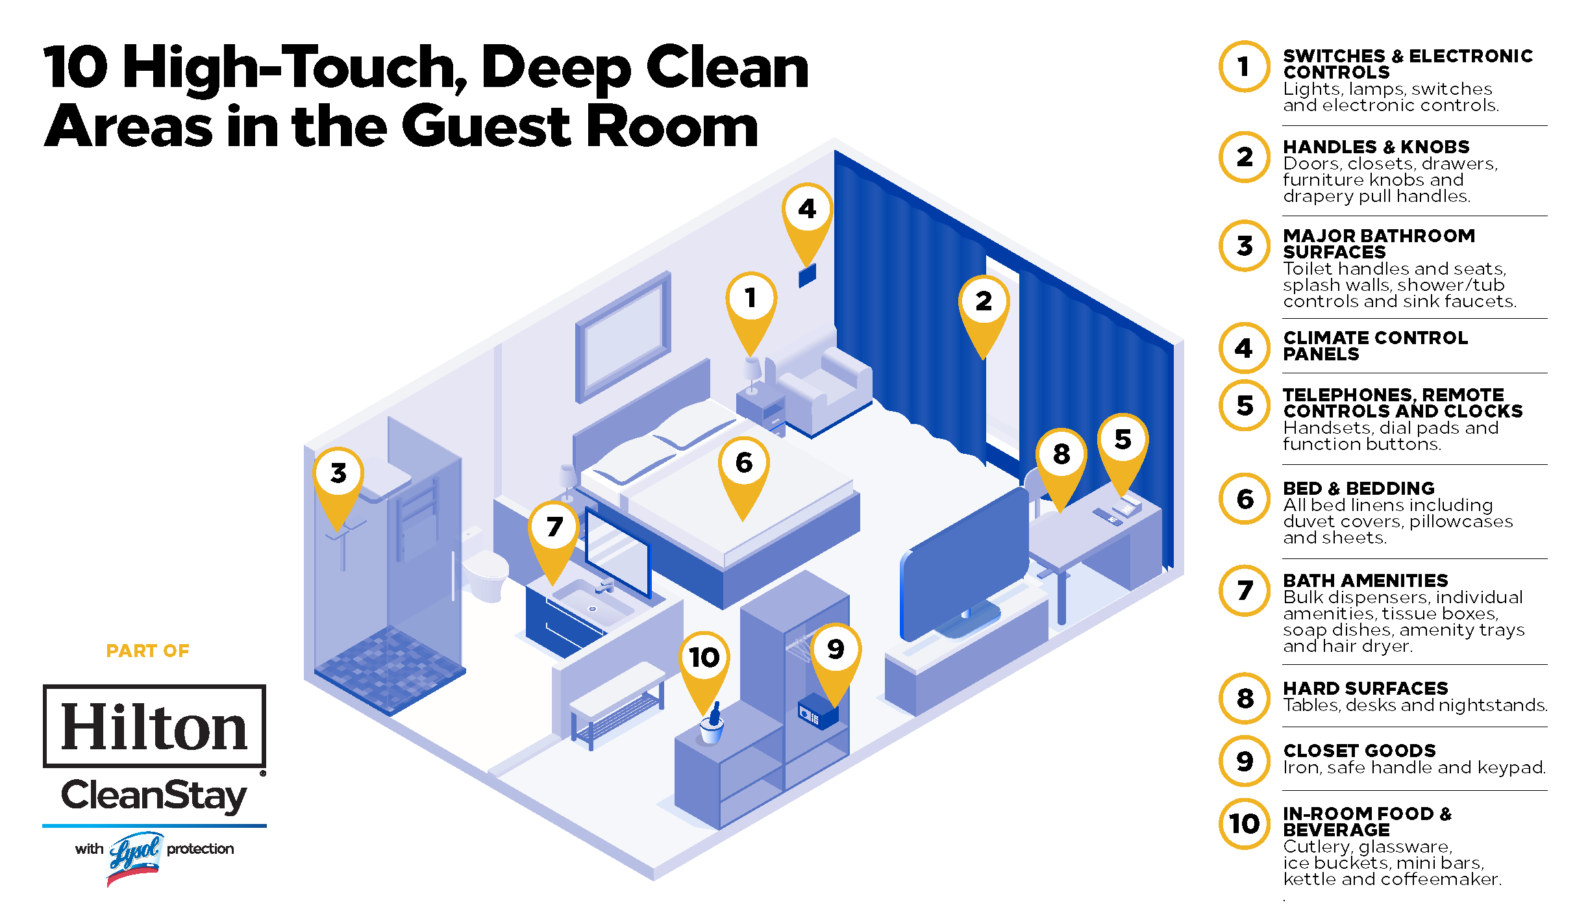
HILTON NEWS

Slide 4
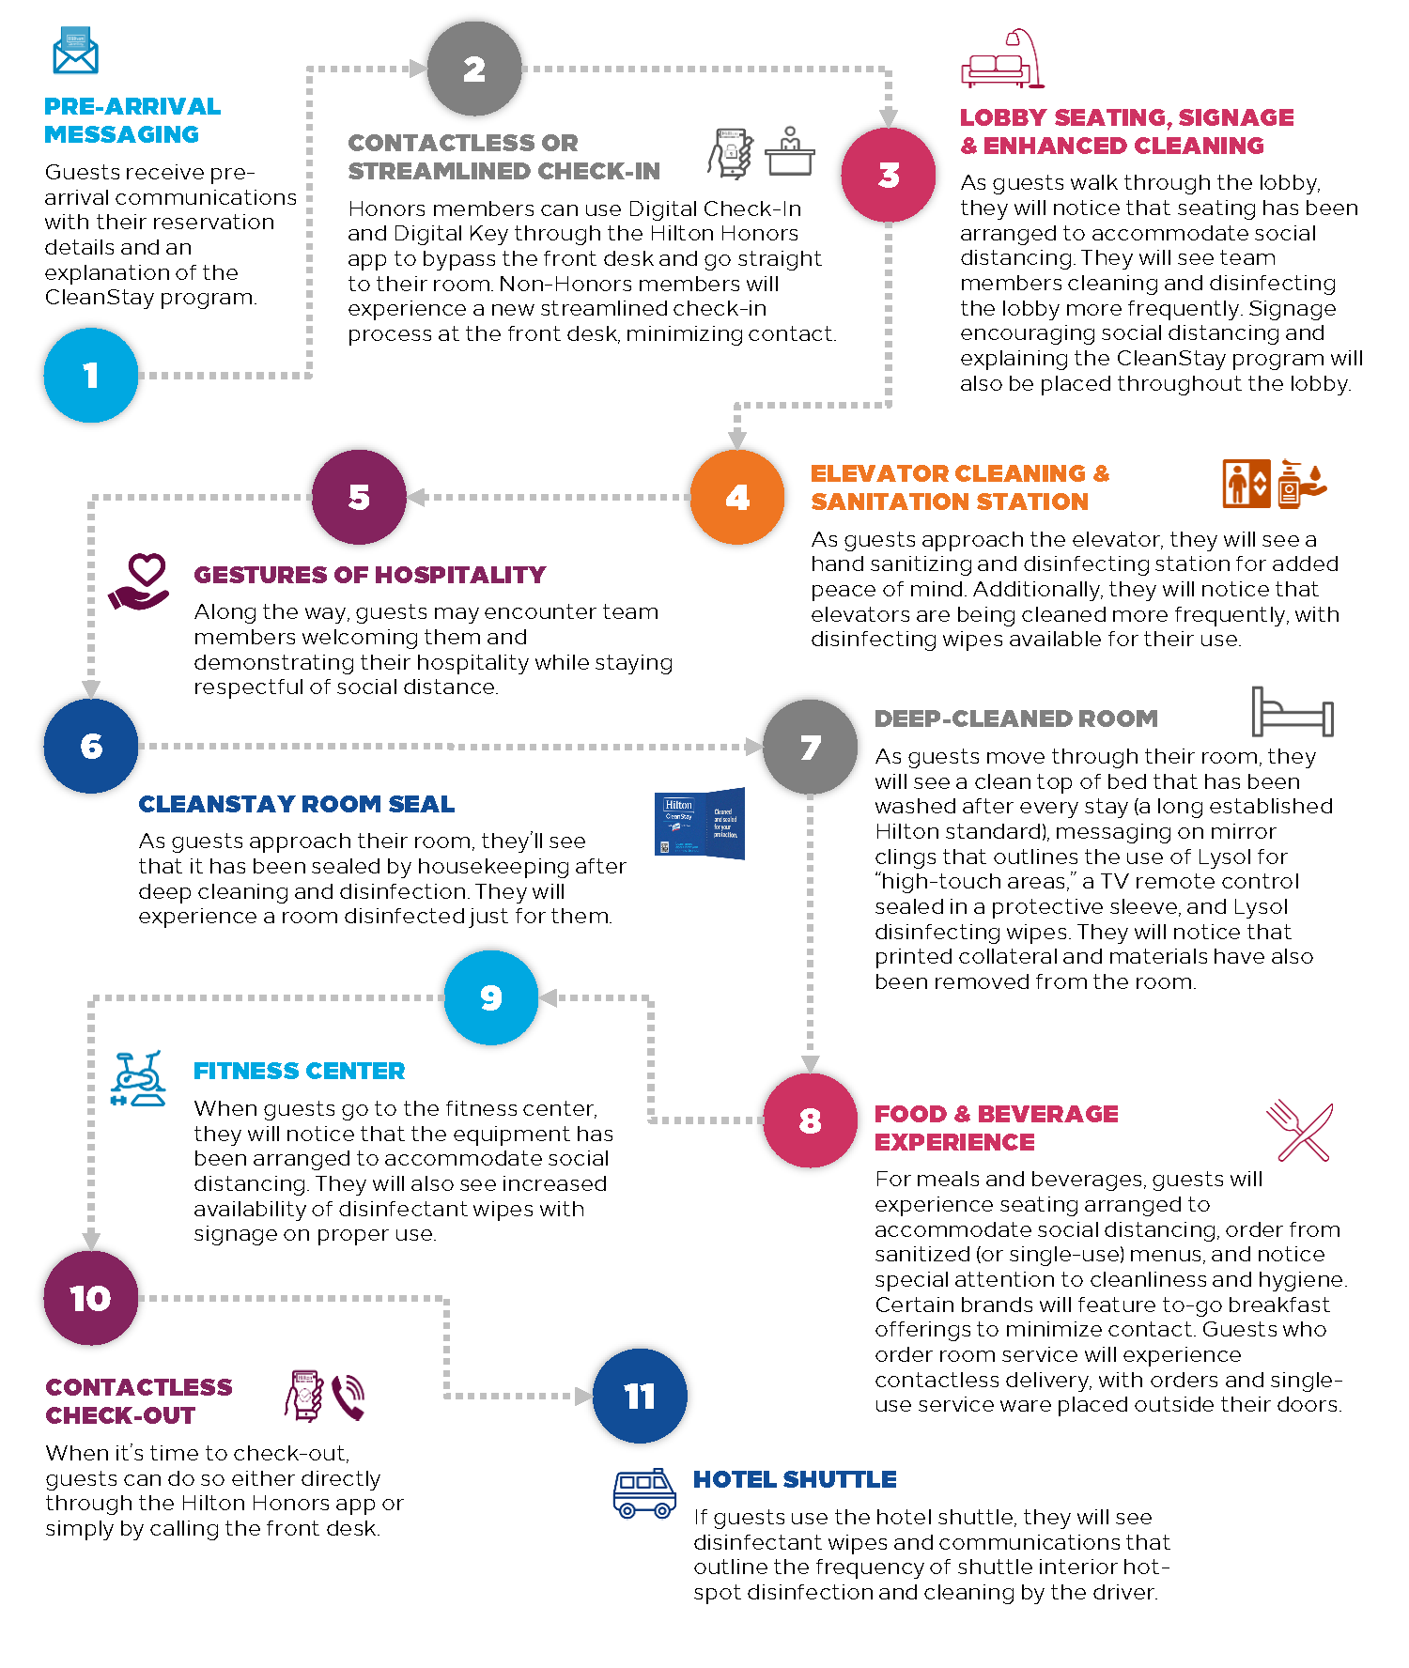
The CleanStay Guest Experience
What travelers can expect during their stay.

Slide 5
To deliver a higher standard of meetings and events
Hilton has launched
Notes:
Building upon CleanStay

Slide 6
Notes:
Launching in hotels August 2020, the goal of Hilton EventReady with CleanStay is to create a safe and comfortable environment for you and your attendees.
Hilton EventReady with CleanStay will provide curated solutions with creative food and beverage, thoughtful technology resources, elevated standards and practices with redesigned spaces for physical distancing, and reimagined ways to meet and gather.

Slide 7
EVENT PLANNING
PRE-ARRIVAL COMMUNICATION
CHECK-IN
ATTENDEE ARRIVAL
Through the entire event journey, EventReady with CleanStay will create a safe and comfortable environment for you and your attendees.
EVENT REGISRATION
EVENT EXPERIENCE
Check-out
Notes:
Entire event journey
Honors App
Appropriate signage along the attendee journey

Slide 8
HILTON NEWS
Introducing…
Hilton CleanStay Standards
Flexible
Safe and Socially Responsible
Partnering with customers to deliver an elevated standard for events across the attendee journey.
Delivering Hilton Hospitality
Notes:
Hilton has developed EventReady, a global meeting and events program designed to create event experiences that are clean, flexible, safe and socially responsible. Hilton EventReady with CleanStay will provide curated solutions with creative food and beverage, thoughtful technology resources, elevated standards and practices with redesigned spaces for physical distancing, and reimagined ways to meet and gather. The goal is to create a safe and comfortable environment for event planners and their attendees.

Slide 9
HILTON CLEANSTAY STANDARDS
Hilton CleanStay Standards provide elevated cleanliness and sanitation across the entire attendee journey. A cleaning protocol is completed to verify an event space is sanitized and disinfected thirty minutes prior to event start
Sanitizing stations will have prominence in primary entryways as well as key high traffic areas including inside and outside event space(s), meal and beverage service areas, public restrooms and congregating areas.
Vendor compliance to all standards and floor plans submitted to hotel for approval in advance of event.
Completed EventReady Room Checklist is provided to planners.
Hilton CleanStay Event Room Seal is applied once the room is properly cleaned, set and EventReady.
Hilton CleanStay Standards
Flexible
Safe and Socially Responsible
Delivering Hilton Hospitality

Slide 10
FLEXIBLE
Sales and Customer Partnerships grounded in transparency and the importance of shared objectives. Providing flexible pricing, space options and contract terms.
Responsive to meet the evolving needs of our customers.
Small Meetings offer with simplified EXPRESS agreements at participating hotels.
Hilton EventReady with CleanStay Playbook delivering expert guidance and curated resources for topics such as:
Hybrid Events
Technology
Wellness
Creative Networking
Transportation/Logistics
Community Service
Hilton CleanStay Standards
Flexible
Safe and Socially Responsible
Delivering Hilton Hospitality

Slide 11
SAFE AND SOCIALLY RESPONSIBLE
Respecting physical distancing with creative and customized event sets and meal services.
Inspiring food and beverage menus: thoughtfully served, timely and flexible. Meals, services and operational procedures adhering to regional physical distancing regulations, amplified hygiene & sanitation requirements, additional space to accommodate attendee flow.
Contactless experiences with digital check-in and check-out, digital key for guestrooms and contactless communication.
Environmental impact solutions measured by LightStay, Hilton’s award-winning corporate responsibility measurement platform.
Community service experiences to support and uplift the local community.
Team Members are educated on the symptoms of COVID-19 and are prohibited from coming to work if they are ill or symptomatic following local ordinances.
Hilton CleanStay Standards
Flexible
Safe and Socially Responsible
Delivering Hilton Hospitality
Notes:
Attendees who desire a contactless arrival experience can check-in, choose their room, access their room with a digital room key and check-out using their mobile devices through the Hilton Honors mobile app. Hilton is carefully monitoring guidance from the WHO and CDC and other health officials that may require health and symptom checks. Where required by law, Team Members must adhere to conducting daily health and symptom self-screenings and/or temperature screenings before entering a hotel or corporate office.

Slide 12
HILTON CLEANSTAY
EventReady with CleanStay is a global meeting and events program designed to create event experiences that are:
FLEXIBLE
DeliverING
Hilton
HOSPITALITY
Clean
flexible
SAFE AND SOCIALLY
safe and socially responsible
Notes:
The entire experience is delivered with Hilton hospitality.
While we are implementing new guidelines, it was important that our new procedures and processes did not impact the core of who we are.

Slide 13
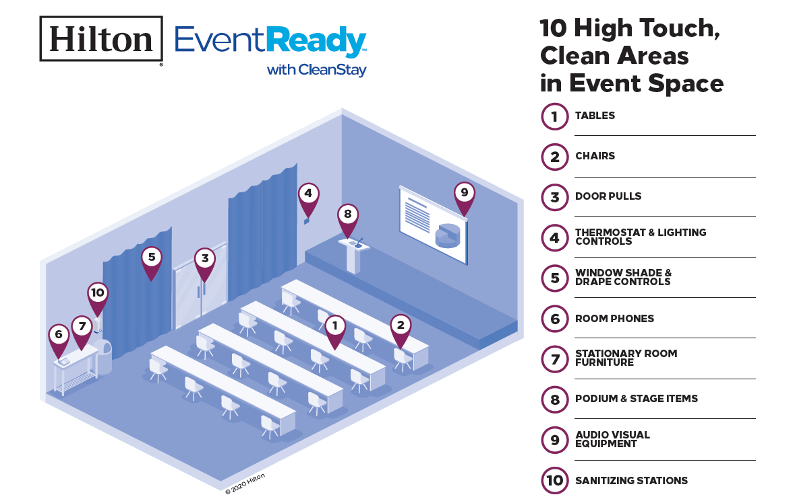
HILTON NEWS

