Slide 1

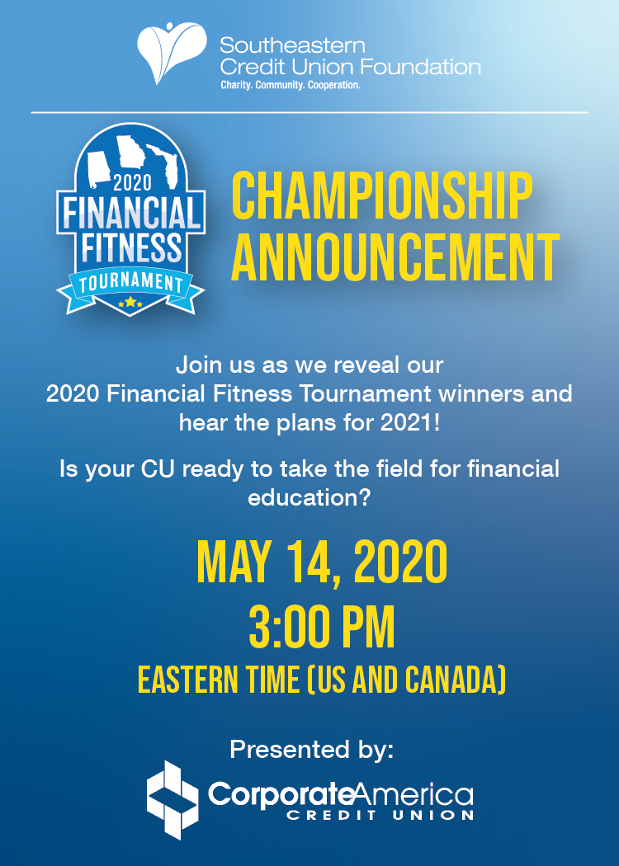

Slide 2


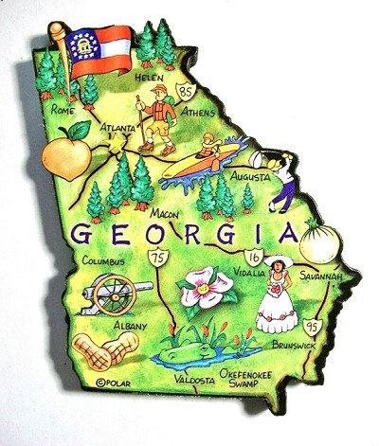
Thank you to our credit unions!
Family Savings CU
Alabama Teachers CU
Valley CU
All In FCU
ASE CU
Alabama One CU
Naheola CU
Alabama River CU
Suncoast CU
Keys FCU
Grow Financial FCU
Southernmost Chapter
SUN CU
Family Savings CU
Georgia Power Valdosta FCU
Marshland Community FCU
Go Energy Financial CU

Slide 3
Why do Credit Unions Care?
44% of Americans don’t have enough cash to cover a $400 emergency.
The median out-of-pocket cost for an unexpected medical expense is $1,000, which means nearly half of our country is just one accident away from being hit with a bill they can’t afford to pay.
43% of student loan borrowers are not making payments.
Tuition at public four-year institutions has increased by 213% in the past 30 years and nearly half of the 22 million Americans with federal student loans are either behind on payments or received permission to postpone payments due to economic hardship.

Slide 4
Not-So-Shocking Stats
38% of U.S. households have credit card debt.
On average, they owe $16,048 with an APR of 16.47%.
The median out-of-pocket cost for an unexpected medical expense is $1,000, which means nearly half of our country is just one accident away from being hit with a bill they can’t afford to pay.
33% of American adults have $0 saved for retirement.
Furthermore, 56% of American adults have less than $10,000 saved for retirement when you combine the 33% who have nothing saved with the 23% who have a small amount saved.
Considering the fact that most Americans will need at least $1 million to retire and Millennials will likely need between $1.8 and $2.5 million, our savings rate is terrifying.

Slide 5
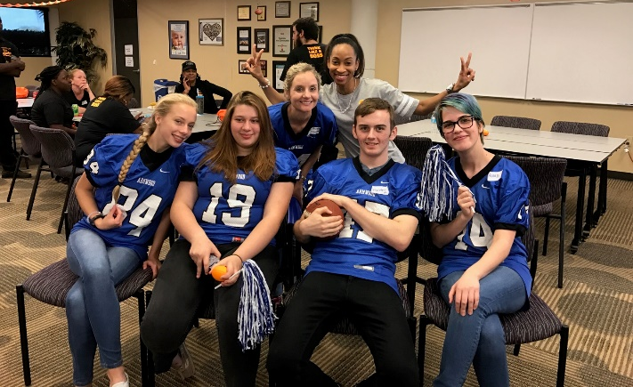
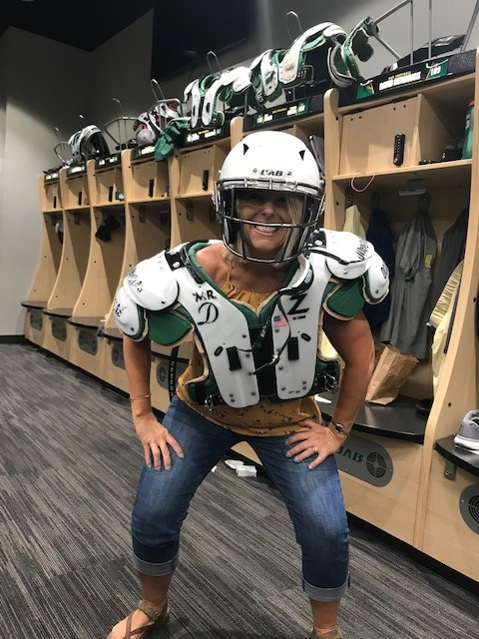

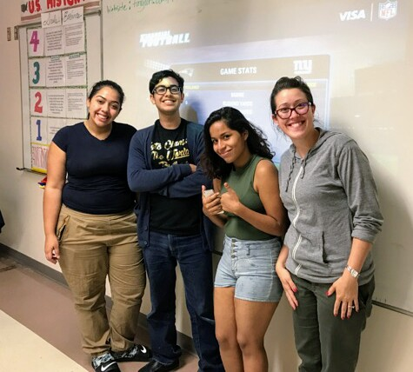
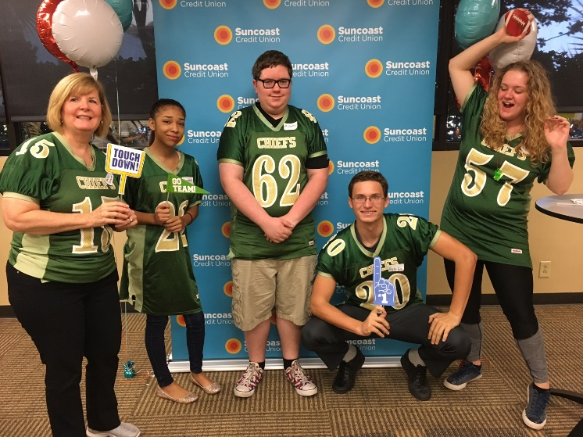
Financial Fitness Tournament

Slide 6
Take the Field for Financial Education!
Who are the teams?
YPGs, Chapters or individual credit unions may register teams of up to 3 high school level students each with a $250 sponsorship. Sponsorships can be covered by the CU, Chapter, Chamber or other approved local organizations. There is no limit to the number of teams that may be sponsored! The students do not have to attend the same school and may even be children of credit union employees.
What can the students win?
Lots of prizes, including CASH (1st place: $1,000 each, 2nd place: $500 each, 3rd
place: $300 each!). The top five teams also get an expense paid trip to battle it out during our annual convention in June (under normal circumstances)…
along with other surprises. ALL participants receive shirts and priceless financial knowledge!
What can the sponsor win?
Besides bragging rights, the Chapter/YPG/Credit Union representing the winning team will take home the coveted LSCU Financial Fitness Tournament trophy!

Slide 7
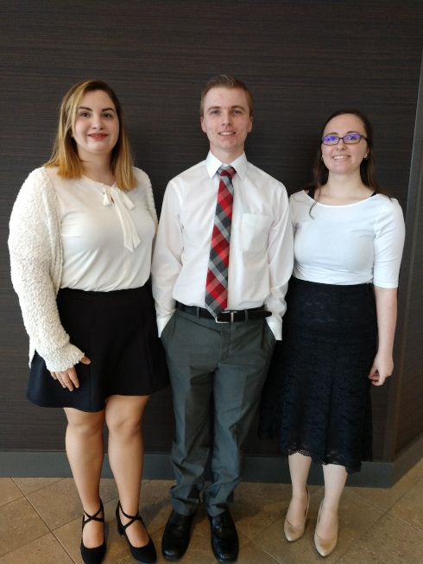
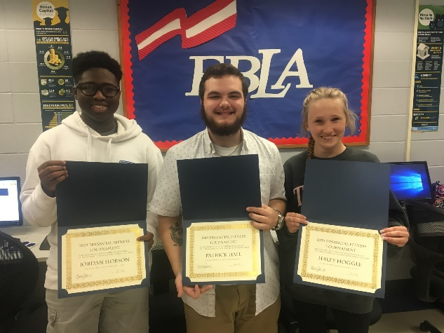
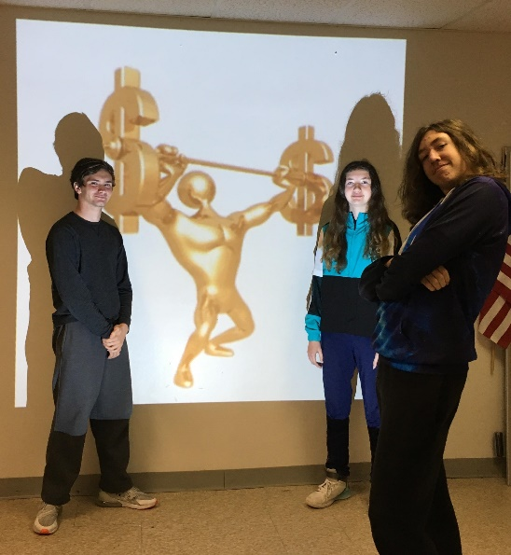
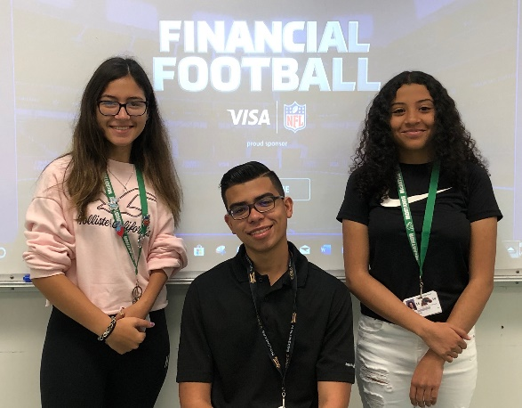
Take the Field for Financial Education!
2021 Financial Fitness Timeline (tentative)
Now-February: Registration (the sooner teams register, the more time they have to study)-link to be sent
March: Local Competitions (for Chapters with more than one team, to determine the team that will represent the Chapter).
April: On-line competitions between Chapter Champion teams
to determine the top 5 teams
June: Final LIVE competition between top 5 teams
(travel and hotel expense paid for students, chaperone and coach)

Slide 8

Ready to Rumble?
It’s not too soon to email me!
Juli.Lewis@lscu.coop

Slide 9



Juli Lewis
850.321.5199
Juli.Lewis@lscu.coop

