Slide 1
How to Hold a Zoom Press Conference
With some help from the LSCU Team!

Slide 2
ZOOM Instructions
Use the instructions from Zoom to create an account, which is free to use.
https://support.zoom.us/hc/en-us/articles/201362033-Getting-Started-on-Windows-and-Mac

Slide 3
Create a Zoom Meeting/Press Conference
Use the instructions from Zoom to create a meeting.
You can learn how to do that here.
Make sure you invite everyone you would like to participate.

Slide 4

During the Zoom Meeting
During the Zoom Meeting/Press Conference, be sure to “Mute” are the participants except the individuals who will be speaking.
Speakers should have their “video” button (located at the bottom left hand of the screen) turned to “on.”
Speakers should have their microphone button (located at the bottom left hand of the screen) turned to “on.”

Slide 5
During the Zoom Meeting cont.
Before the meeting/press conference starts, make sure you hit the “record” button.
At the end of the meeting, hit the record button to stop.
The meeting will automatically save.

Slide 6
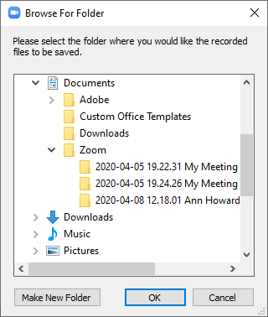
When the Zoom Meeting Ends
Once the meeting is converted to be saved, you’ll see this message:
Just decide where you want to save the meeting recording and hit “OK.”

Slide 7

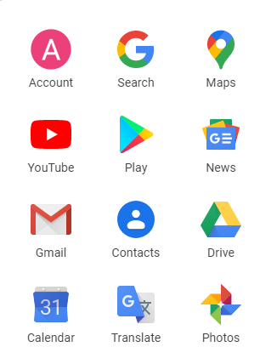
Uploading the Zoom Meeting for Delivery
Using Google, open up the Google Drive using the button with nine dots in the upper right hand corner.
Then, select Good Drive from this menu.

Slide 8
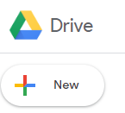
Uploading the Zoom Meeting for Delivery cont.
In the upper left hand corner, look for the “New” button.
Click the “New” button.
Then, click “File Upload.”

Slide 9
Uploading the Zoom Meeting for Delivery cont.
You’ll see a menu for you to select the video from where you saved it.
Click the video and it will upload to Google.
Once loaded, you can email the shareable link to the media who’s requested it.
The media member can download and edit the video.

Slide 10

Zoom Press Conference Instructions
And now you’ve held a press conference
while adhering to social distancing
recommendations and orders!
Please contact Ann.Howard@lscu.coop
with any questions.

