Slide 1
What to Expect from Your Regulators in 2019

Slide 2
New and Old Examiner Concerns
State Credit Unions Update
Loans and the economy
Liquidity and Interest Rate Risk
Information Security
Keeping Up?
Documenting
Next Gen Management

Slide 3
Number of Credit Unions by Asset Size
December 31, 2018 December 31, 2017
Less than $2 million 1 1
$2 - $5 million 2 2
$5 - $50 million 20 22 $50 - $100 million 10 9
$100 - $500 million 13 12
$500 million - $1 billion 10 10
$1 billion and over 10 9
Total 66 65
As of December 31, 2018, total assets held by state chartered credit unions amounted to $45.24 billion. This is an increase since the December 31, 2017, figure of $41.39 billion.

Slide 4
Return on Average Assets (ROAA)
Credit Unions are generally more profitable.
For 2018, approximately 29% or 19 credit unions reported a ROAA between 0.0% and 0.49%, 44% or 29 credit unions reported a ROAA between 0.50% and 0.99%, and 20% or 13 credit unions reported a ROAA at or above 1.00%. An increase in each of the top two brackets.

Slide 5
Econ 101 – Housing Median $257,500

Slide 6
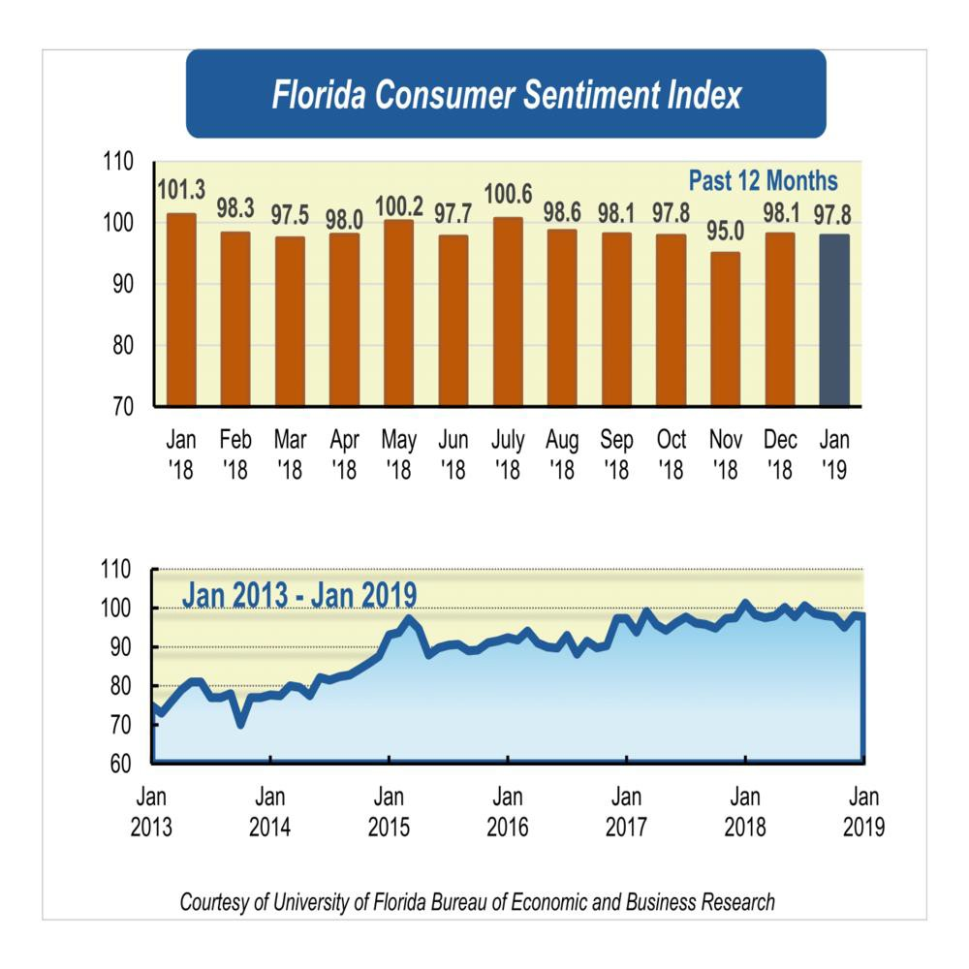

Slide 7
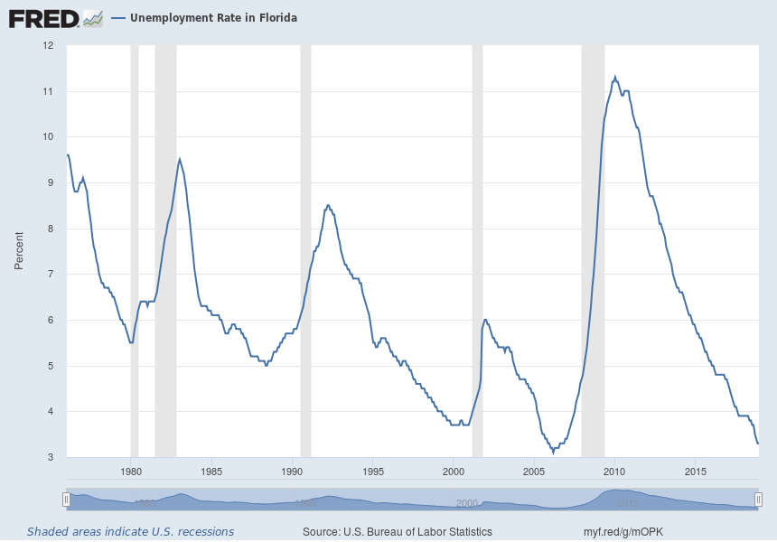
Unemployment and Delinquency Are Related
Notes:
Source: U.S. Bureau of Labor Statistics Release: State Employment and Unemployment Units: Percent, Seasonally Adjusted Frequency: Monthly U.S. Bureau of Labor Statistics, Unemployment Rate in Florida [FLUR], retrieved from FRED, Federal Reserve Bank of St. Louis; https://fred.stlouisfed.org/series/FLUR, February 7, 2019.

Slide 8
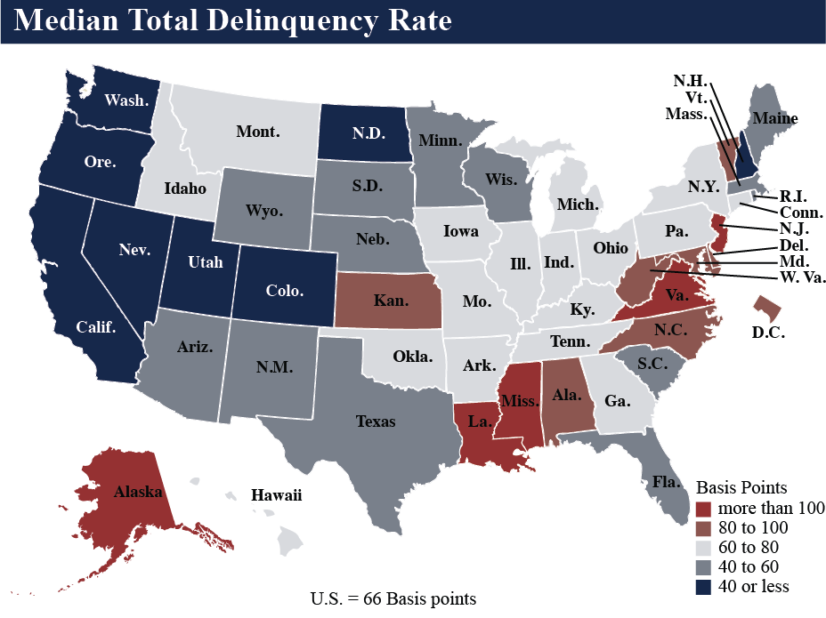
3rd Quarter Median Total Delinquency Rate (NCUA)

Slide 9
Economics
Yield Curve Tells the Fed to Hold on Rates
If this keeps up, a key recession warning indicator soon will be flashing red.
By Noah Smith
January 2, 2019

Slide 10
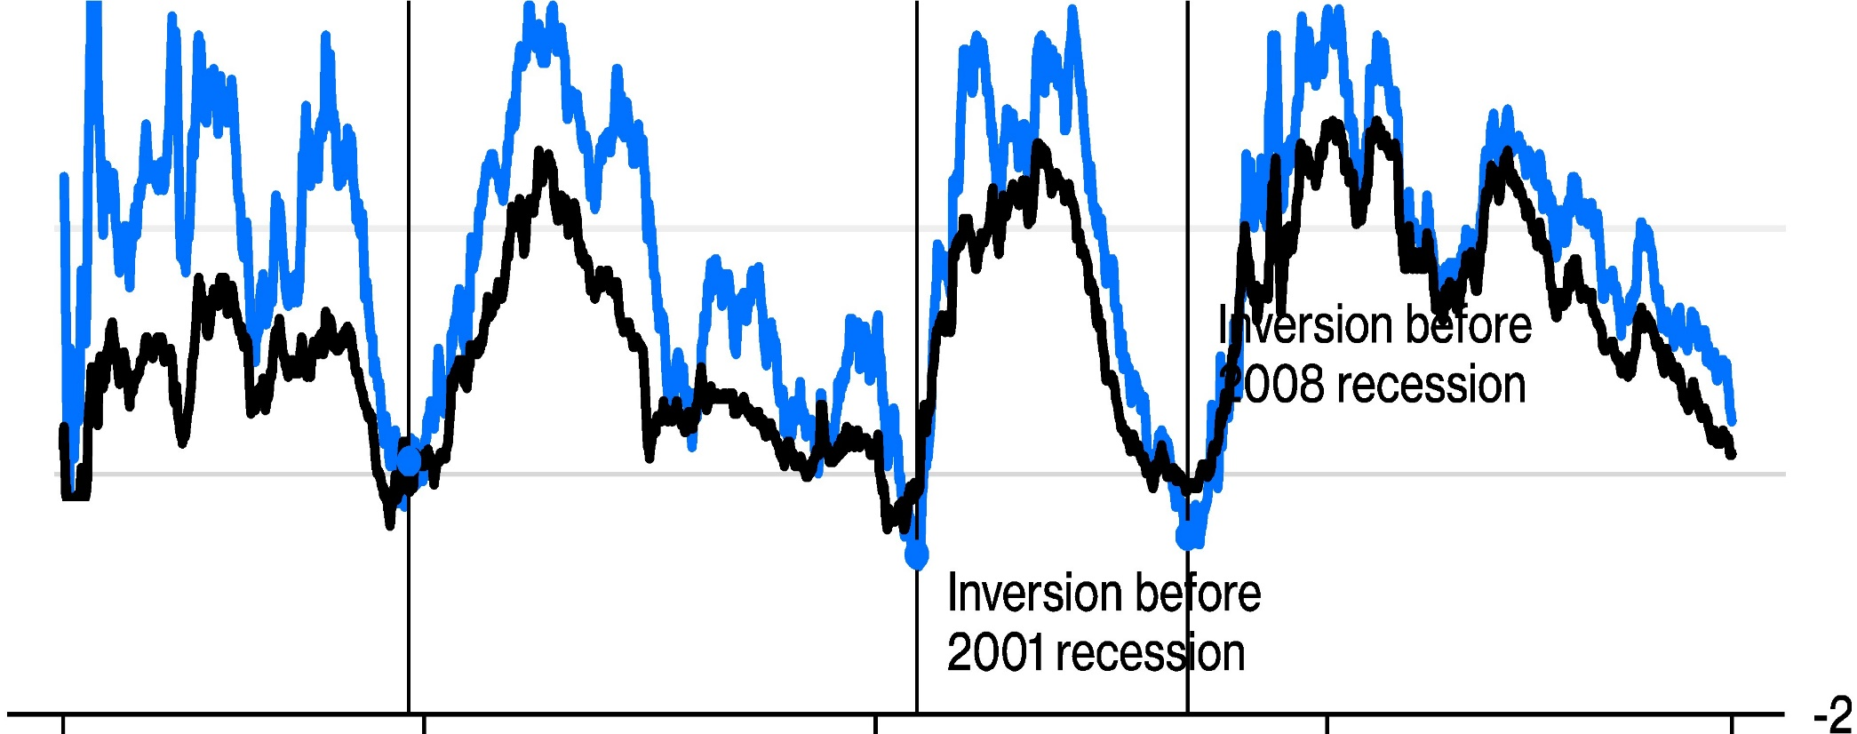
Inversion Ahead of the Storm
Treasury term spreads for different maturities Three-month vs 10-year Two-year vs 10-year
Inversion before 1990 recession
1982 1990 2000 2010 2018
Source: Federal Reserve Bank of St. Louis

Slide 11
Auto Prices
Collateral Value Up?

Slide 12
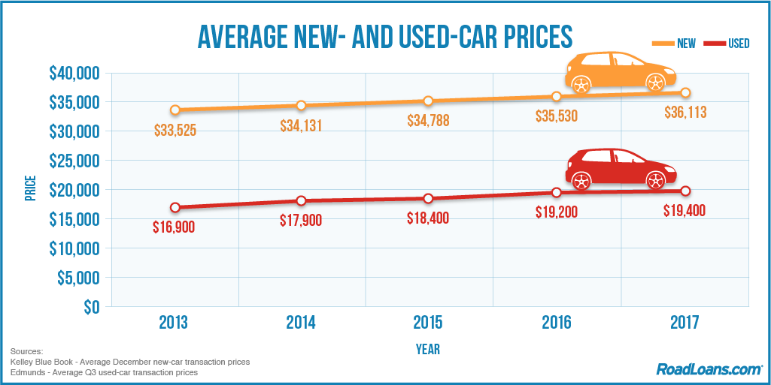

Slide 13
Auto Prices
New-car prices have risen in step with the economy since the Great Recession and the average price is now beyond the means of most median-income Americans, says Bankrate.com, which based its calculations on the 20/4/10 rule of a 20 percent down payment, four-year loan and payments of principal, interest and insurance making 10 percent of a household’s income.
Numerous factors affect increasing prices and growing demand for large SUVs and trucks, which are more expensive than most passenger cars, has also played a part.
With the cost of new cars at these levels, and taking into account depreciation after purchase, used vehicles may become increasingly attractive options. In fact, around 40 million used cars, more than double the number of new ones, are sold each year. [May become??]
https://roadloans.com/blog/average-car-price

Slide 14
Prime vs Subprime Auto
Small CUs Know the Relationship, but in the big blue world (competition)…
According to the latest report S&P Global Ratings, the firm explained that its subprime index became more heavily weighted toward deep subprime issuers between 2007 and 2017. Analysts acknowledged these issuers’ pools tend to have three characteristics, including:
— An expected cumulative net loss of 20 percent or more
— Weighted average FICO of the pools tends to be 550 or lower
— Many of the obligors don’t have a credit bureau score.
While the subprime sphere has some sour numbers, S&P Global Ratings pointed out other portions of the ABS market are performing much better.
Analysts indicated prime losses declined to 0.47 percent in May from 0.53 percent in April and 0.60 percent a year earlier

Slide 15
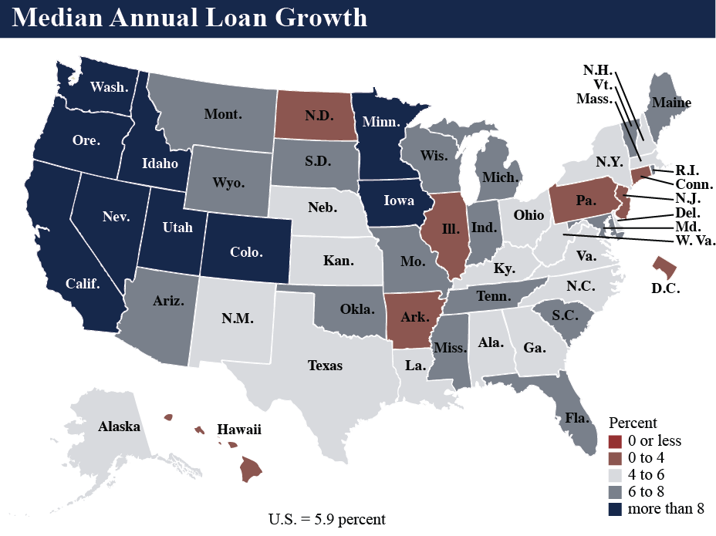
3rd Quarter Median Annual Loan Growth (NCUA)

Slide 16
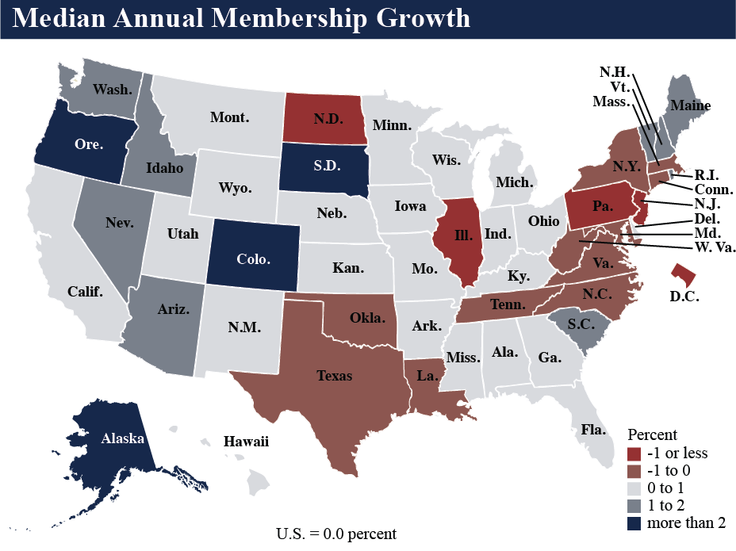
3rd Quarter Median Annual Membership Growth (NCUA)

Slide 17
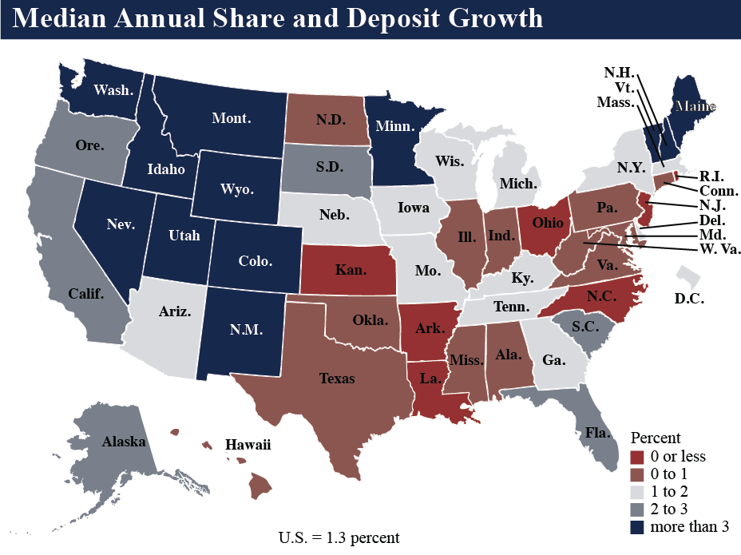
3rd Quarter Median Annual Share and Deposit Growth (NCUA)

Slide 18
Liquidity Factors
Florida Median Loan to Share 69%
Florida Median Asset Growth 2.3%
Florida Median Share Growth 2.2%
Florida Median Loan Growth 6.5%
Over the past five years, the average credit union loan-to-share ratio has increased 15.5 percentage points. [Nationally]
In the second quarter of 2018 quarter alone, it has increased 2.3 percentage points, reaching 82.9%, and remains only 86 basis points below the record high reached in September 2008… (https://www.cuinsight.com/loan-to-share-ratio-nears-record-high.html)

Slide 19
Member Information Security
The Credit Union’s Information Security Program should include at a minimum:
Risk assessment:
identify foreseeable internal and external threats
Assess the likelihood and potential damage from the threats identified
A written information security program to control identified risk
Provide training to staff
Test key controls, systems, and procedures of the program. (Consider Phishing tests).
Procedures to properly dispose of member information
Incident response plan
Board report, review and approval ANNUALLY (12 CFR Part 748 Appendix A )

Slide 20
Member Information Security (continued)
Format of the report should describe the overall status of the information security program and the credit union's compliance with these guidelines. The report should discuss material matters related to its program, addressing issues such as: risk assessment; risk management and control decisions; service provider arrangements; results of testing; security breaches or violations and management's responses; and recommendations for changes in the information security program. (12 CFR Appendix A to Part 748)
Consider testing staff for Phishing vulnerability
Dave due to your hard work… you have won a new big screen TV!!!

Slide 21
Top Examiner Review Questions
Does the credit union have a Board approved Information Security Policy?
Has the credit union performed an Information Security risk assessment?
Obtain and review IT audits, internal or external vulnerability scans, penetration tests.
Does the credit union require strong passwords for its network and core systems?
Assess the frequency of data back up, location of back up, and encryption of data.
Does the credit union have information security training for all employees with documentation?
Does the credit union have an incident response plan?
Did the Board get an annual summary which mentions the appropriate items?

Slide 22
Spear Phishing

Slide 23
Will This Affect Me???
Phishing Attack Targets Bank & Credit Union BSA Compliance Officers – 02/08/2019
As you may now know, a phishing scam targeting BSA compliance officers at credit unions and other financial institutions was reported this week by KrebsOnSecurity. The article originally singled out the attacks on credit unions but was later updated to reflect that attacks targeted bank BSA compliance officers as well…
https://krebsonsecurity.com/2019/02/phishers-target-anti-money-laundering-officers-at-u-s-credit-unions/

Slide 24
Will This Affect Me??? (cont)
What made these phishing attacks notable was that they were directed to the BSA officers of credit unions and banks by name. The phishing emails purported to be from named BSA officers at other financial institutions. The emails informed the recipient BSA officer that a suspicious transaction by one their customers had been put on hold by the “sending” institution and asked the recipient to open an attached PDF to review the frozen transaction. The body of the PDF contained a link to a malicious website.
Notice: “FinCEN is aware of a fraudulent email purporting to be from a financial institution regarding the 314(b) Information Sharing Program. The recipients of the email are typically other financial institutions.”

Slide 25
Will This Affect Me??? (cont)
It would be prudent to remind staff of best practices in handling email to guard against phishing attacks (cyber hygiene). Best practices include:
Hovering over the sender in the email to verify the sending address;
Being alert for misspellings and grammatical errors;
Verify sender before opening attachments and clicking on links; and
Using the phone to verify the sender is legitimate.

Slide 26
Credit Union Times - 06/14/2017
Breaches Double at FIs
March 2016 vs March 2017

Slide 27
Cyber Security Control Basics
“A Journey of a thousand miles begins with…
The first five steps.”

Slide 28
Top Five Things
Hardware Inventory
Software Inventory
Configuration
Continuing Assessment and Remediation
Controlled Administrative Privilege

Slide 29
Cyber Security – First Five Controls (of 20) from: The Center for Information Security CIS
Why Use The CIS Controls?
Many organizations facing the current cybersecurity environment are overwhelmed by what we call the “Fog of More”—a constant stream of new information and problems. They are challenged by competing expert opinions, a noisy and fast-changing marketplace of potential solutions, and unclear or overwhelming regulatory and compliance requirements
Getting Started
A number of studies show that implementation of the First 5 CIS Controls provides an effective defense against the most common cyber attacks (85% of attacks). In an effort to help organizations implement the First 5 CIS Controls, the objective of each is described next.

Slide 30
Cyber Security – First Five Controls
1
Inventory of Authorized
& Unauthorized Devices
(IOT?Tablets, Phablets, Phones of all kinds?)
2
Inventory of Authorized
& Unauthorized Software

Slide 31
Cyber Security – First Five Controls
3
Secure Configurations for Hardware & Software
on Mobile Devices, Laptops, Workstations, & Servers
https://www.cisecurity.org/cis-benchmarks/

Slide 32
Cyber Security – First Five Controls
4
Continuous Vulnerability
Assessment & Remediation
5
Controlled Use of
Administrative Privileges

Slide 33
Member Information Security
Social Engineering and Training

Slide 34
OFR Examination Process
A well organized and completed Pre- Exam Package = An efficient/thorough review and less time on-site for the examiners.
Budgeted Hours.
NCUA Exam Participation.
Succession Planning and Management
Asset Liability Committee and an increasing rate environment.
More emphasis on off-site work, see 1. above. Also, conference calls.

Slide 35
OFR Examination Process
Succession

Slide 36
OFR Examination Process
CU The Next Generation - Succession Planning
Senior Staff / CEO
Board and Committees

Slide 37
OFR Examination Process
More Emphasis on Off Site

Slide 38
Conference calls

Slide 39
Questions???

Slide 40
The information conveyed via the videos and slides is educational information and not an endorsement of any particular vendor. The information is the opinion of the source, or speaker and not necessarily OFR.

Slide 41
Contact Information:
Dave Molitor
David.Molitor@FLOFR.com 813-218-5360

